Slide 1
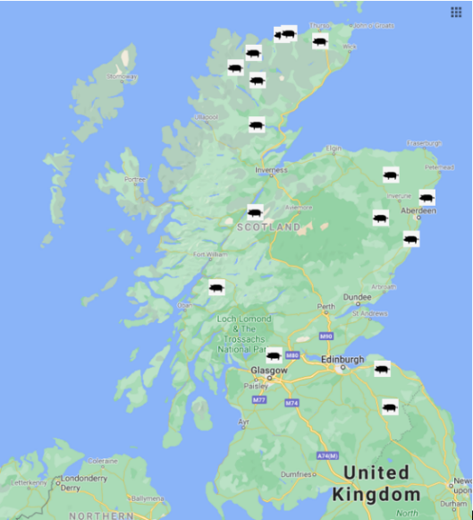
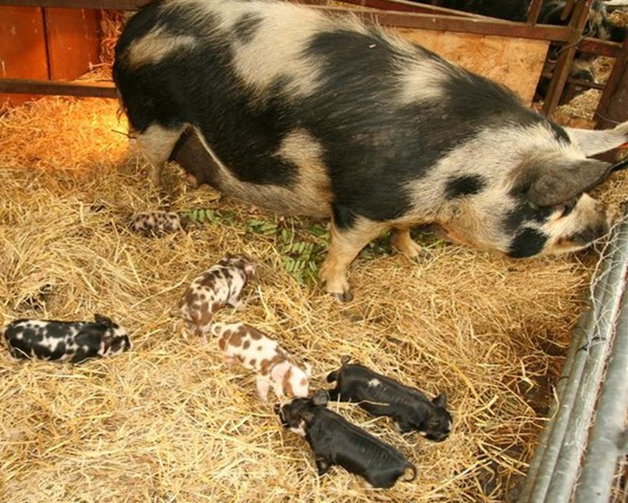
Understanding attitudes to biosecurity in small-scale pig keepers.
Carol Kyle¹, Lee-Ann Sutherland¹, Thibaud Porphyre²
¹James Hutton Institute, Craigiebuckler, Aberdeen AB15 8QH
²VetAgro Sup, Campus vétérinaire de Lyon, France
carol.kyle@hutton.ac.uk
INTRODUCTION:
African swine fever, which is well-established in Europe, is a devastating disease of pigs and wild boar that could have disastrous consequences for the commercial pig sector in the UK and be distressing for all pig keepers.
There is clear evidence to show that climate change is happening, with the UK seeing its nine warmest years since 2002. This rise in temperatures could result in the incursion of livestock diseases like African swine fever (ASF) as yet not seen in the UK.
While the commercial sector should have high levels of biosecurity and be aware of existing regulations, very little was known about the attitudes to biosecurity and understanding of regulations among small- scale keepers.
Small-scale keepers managing modest areas of land are generally considered outliers among the farming community.
Their activities are seen as recreational, low impact and therefore benign. They are integral to rural communities socially and with regard to food security, supplying low input, locally produced food that is generally perceived to be healthier, more ethically produced and better for the environment.
However, the importance of small-scale keepers increases dramatically when considering the threat of livestock diseases and their approach to biosecurity.
Research Structure
Semi-structured interviews were carried out with 13 female and 4 male Scottish smallholders and crofters, aged between 31 and 65 with varying degrees of educational achievement.
Figure 1
Participants were recruited via Facebook groups and by snowballing technique where participants contact friends and other interested parties on behalf of the researcher.
There was a good geographical spread of participants (Figure 1). Holdings ranged from approximately 2 acres to over 200 acres either on rough hill ground or more productive low ground. Experience of pig keeping ranged from novice first- time keepers to highly experienced keepers that had owned pigs for over 10 years.
No keeper kept more than 15 adult pigs at any one time though many bred their pigs, so there were often more on the holding for short periods as piglets grew and were then sold. Although a small sample, saturation was reached in the 16 interviews* i.e., no new information was being revealed in interview content.
(*one interview was with a couple)
Findings
All the participants interviewed were aware of ASF at the time of the interview, either via information from animal health authorities or the breed societies and Facebook.
Due to a combination of being geographically remote in Scotland, the absence of feral pigs/wild boar in their area, or because they had very little contact with other pigs or pig keepers, participants were not concerned about their pigs contracting ASF. Some, but not all participants were aware of the impact ASF would have on the commercial pig industry.
Keepers were aware of the need for good biosecurity both on their holding and when transporting animals. They were conversant with government regulations particularly around feeding household scraps and meat products, understanding the rationale behind the restrictions. Some were concerned about the increased footfall in their area following Covid- 19 and the risk that posed to their pigs and biosecurity in general.
All the study participants were either registered with a veterinary practice or had contact with a vet. They commented that vets in general practice do not typically have much experience with smallholders’ pigs and seem to be happy to ‘leave the keepers to it’.
He [the vet] really said pigs they take care of themselves, they’re quite hardy, they really don’t need the kind of interference and the drugs and all that, that some sheep do.
If faced with a sudden death of a pig, participants said that they would
react differently depending on the age of the pig and the situation in which it was found.
In a case of an unexpected death, they would request veterinary attention and perhaps request a post-mortem.
Dead pigs were either collected as fallen stock or, contrary to regulations, buried on site.
Newly weaned piglets are generally no larger than a Labrador dog. Participants reported buyers picking piglets up in dog crates and /or in the back of a vehicle rather than in trailers, which may be a biosecurity issue as cars are not easy to clean.
…Yeah, there is one that sort of sticks out, this lady and her mum arrived all the way from Thurso and the pigs were just going into their estate [car] which they’d lined with her mum’s incontinence pads. It was the hottest day of the year and you just thought oh my god, all the way to Thurso [a five hour journey] with these two pigs.
Conclusions
The consistent responses around small-scale keepers understanding of biosecurity, regulations and pig health and welfare implies that they are well informed on these issues and understand the requirement for regulations around feeding and movement. But in some cases, regulations around carcass disposal are either misunderstood or not complied with.
Many small-scale keepers are in a position where sales of their product relies on personal relationships with the buyer, so honesty, traceability, good welfare and biosecurity is crucial to the success of their (albeit small) business.
They tend to be pragmatically emotionally attached to their stock and want to do the best by them. The small numbers of animals means that they are soon aware of any health issues, and as they are quick to ask for advice, any disease should be promptly dealt with.
Acknowledgements
We would like to extend sincere thanks to all the participants in this study who gave their time to discuss pig keeping so openly and frankly.

