Slide 1
Willow Constructed Wetland Timeline 2017-18
Lisa Avery, Jenni Stockan, Luke Beesley, Matteo Tamburini, Eulyn Pagaling, Joseph Palmer, Adam Wyness, Rupert Hough

Slide 2
Month | Activity
Feb-17 | Constructed wetland media removed, liner and media replaced Septic tank effluent samples taken for preliminary analysis of emerging organic contaminants (pharmaceuticals and pesticides)
Mar-17 | Willow cuttings prepared for planting Samples taken for DNA extraction for screening for AMR Additional sampling Portal system designed New media (gravel) porosity estimated – 38%.
Apr -17 | Both beds planted with new Willow cuttings Site Access Renewed with Scottish Water Two-line influent system designed to facilitate improved control of loading to each bed Some tree disease – cuttings replaced where necessary
May-17 | Issues with cattle present in CW area and around gateway – SW job logged to fix fence Monthly measurements on trees completed Meeting to discuss analysis of emerging contaminants

Slide 3
Month | Activity
Jun-17 | Wastewater applied manually to beds to maintain Willows Monthly measurements on trees completed Delay to installation of new pipelines to beds
Jul-17 | 14 diseased trees removed and replaced Monthly measurements on trees completed
Aug-17 | New pipelines installed to facilitate flow control to both beds Pump control pack fitted Flouts cleaned & tested. Monthly measurements on trees completed Beds weeded Wastewater applied manually to beds to maintain Willows
Sept-17 | Wastewater flow to beds automated Monthly measurements on trees completed Beds weeded Site strimmed
Oct-17 | Media options literature review underway Novel media mesocosm experiment design finalised North bed pump failure and Flout not rising to retain water

Slide 4
Month | Activity
Nov-17 | Effluent sampling & analysis for water quality parameters for both beds initiated Media options literature review completed Novel media mesocosm experiment underway Preliminary sample analyses complete for organic pollutants in primary effluent
Dec-17 | Effluent sampling for & analysis for water quality parameters for both beds continued Novel media mesocosm experiment completed; nutrient & microbial analyses underway Pipes freezing at field site – additional insulation added Biomass samples from 2012-16 operating period submitted for nutrient, metal and TPH analyses
Jan-18 | Microbial diversity samples from 2012-16 operating period analysed Novel media mesocosm nutrient and microbial analyses complete
Feb-18 | Abstract submitted to IWA specialist group on Constructed Wetlands
Mar -18 | Re-analyses of 2012-16 data to calculate hydraulic loading rates Completion of final report for 2012-16 data. Nutrient content of biomass (2012-16) analyses complete Novel media mesocosm emerging pollutant analyses complete

Slide 5
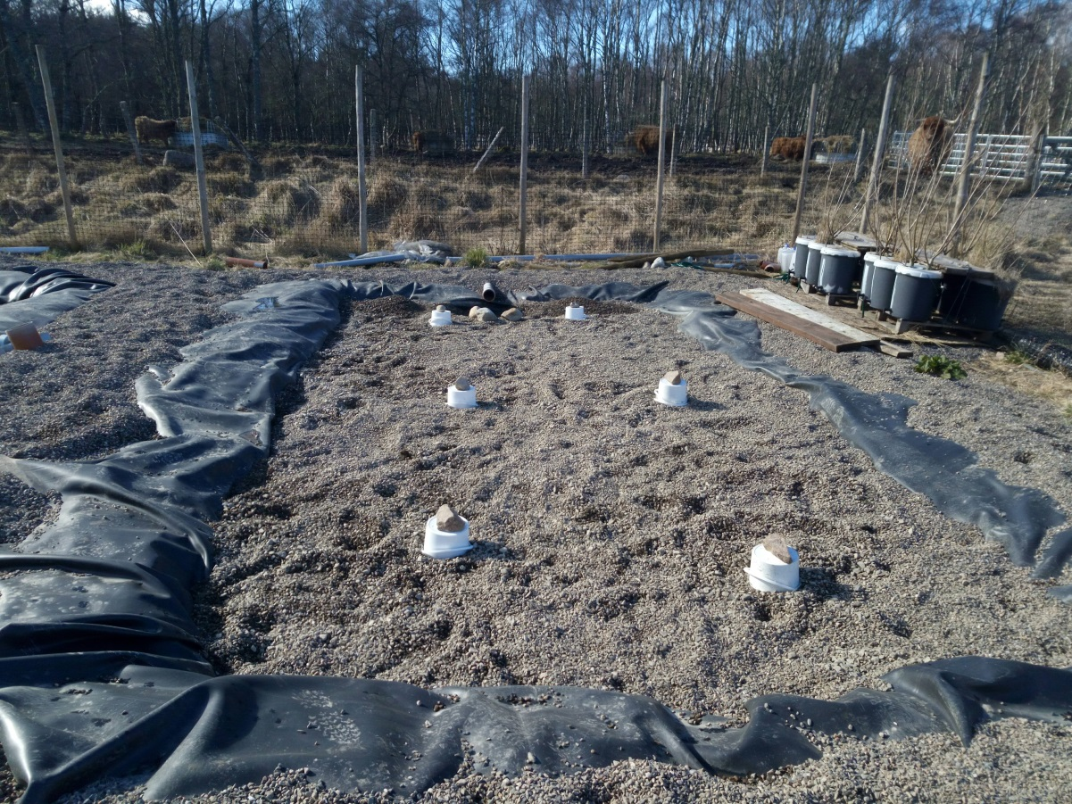
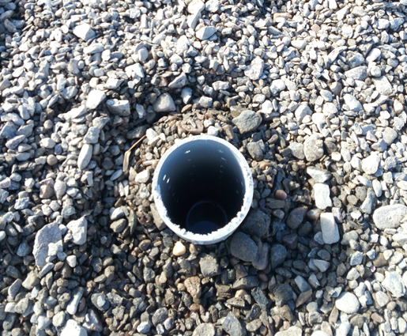
Sampling Portals Installed March 2017
These provide sampling access to understand how treatment processes change across the bed providing greater understanding of mechanisms and therefore allowing us to optimise the treatment system

Slide 6
Willow cuttings planted into fresh media April 2017

Slide 7
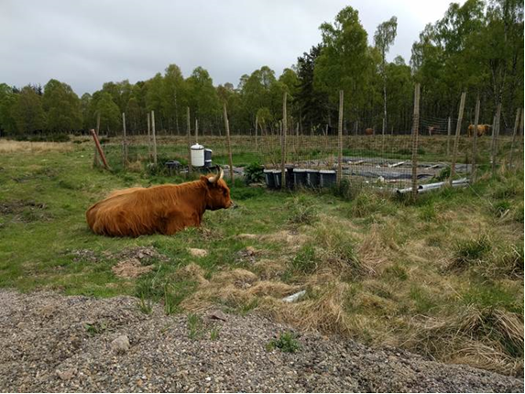
Cattle broke into CW area May 2017
This led to some issues with on-going work as bull also present in the herd

Slide 8
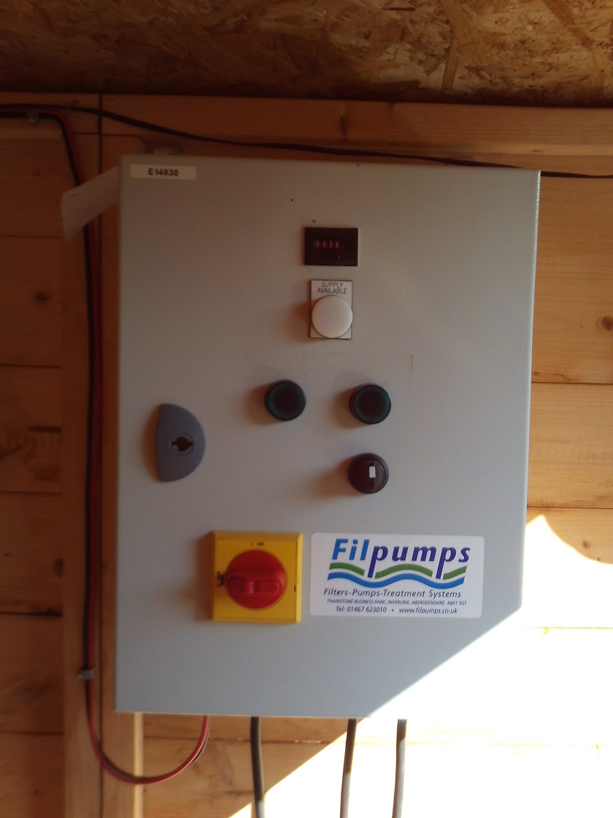
Flow to beds refined – work completed August 2018
New lines were installed such that each bed has its own line and pump. Flow to the beds is determined by the timing of the pump operations and controlled by the panel opposite. This facilitates much greater control of the individual loadings of each bed.

Slide 9
Pharmaceutical
Peaks are insufficiently discrete indicating that dilution of septic tank effluent and additional clean up are required ahead of analyses for novel media mesocosm experiment

Slide 10
Pharmaceuticals and Pesticides
Pharmaceuticals | Samples +ve (n=5) | Pesticides / herbicides/ fungicides/insecticides | Samples +ve (n=5)
BPA | 5/5 | Isoproturon | 5/5
Ibuprofen | 3/5 | Chlortoluron | 5/5
Tramadol | 5/5 | Chlorpyrifos | 5/5
Acetaminophen | 0/5 | Epoxiconazole | 5/5
Triclosan | 5/5 | Permethrin | 5/5
Diclofenac | 4/5 | Cypermethrin | 5/5
Carbamazepine | 3/5 | Metaldehyde | 5/5
Trimethprim | 5/5 | Simazine | 5/5
Benzothiazole | 5/5 | Atrazine | 5/5
Five samples of primary effluent (i.e. influent to the constructed wetlands) were analysed for some major compounds within pharmaceuticals/personal care products/pesticides etc. While data must be interpreted with caution as further optimisation of the methodology is required, all bar acetominophen were detected in at least three out of five samples.

Slide 11
Sampling Campaigns
Due to technical difficulties with the beds, sampling data generated in 2017-18 were limited. Along with the findings of the mesocosm experiment, we aim to build upon these with robust campaigns in 2018-19 to determine the relationship between operational parameters (hydraulic loading rate, retention time) and treatment performance for standard and selected emerging contaminants.

